Slide 1
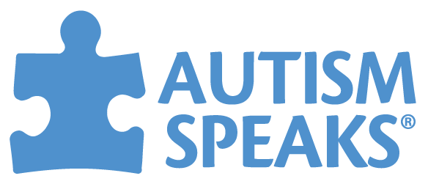
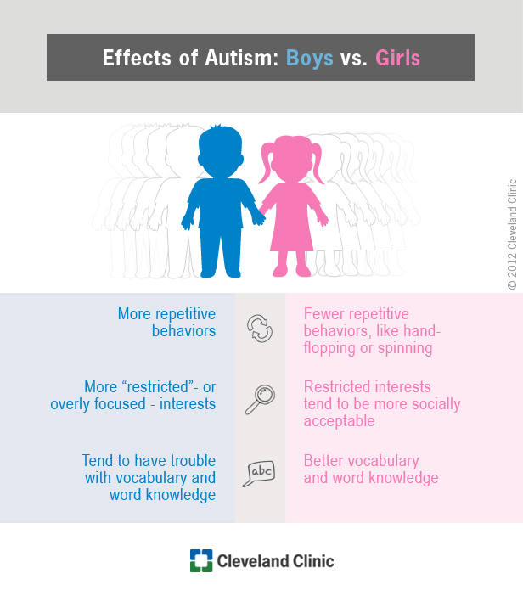
Gender Differences in Autism
Hannah Drewek, Junior, Special Education Major
What is Autism?
Share our similarities. Celebrate our differences.
- M. Scott Peck
Characteristic Differences
The true definition of Autism Spectrum Disorder (ASD) is critical in understanding the gender differences. in children with ASD. The definition of ASD as generated by the Diagnostic and Statistical Manual of Mental Disorders can be defined as including the following diagnostic criteria: “persistent deficits in social communication and social interaction across multiple contexts and restricted repetitive patterns of behaviors, interests, or activities.”¹ Simply, ASD can be characterized as a “social, emotional, and communicative” disorder that involves abnormal behaviors. Specific behaviors of ASD differ based on individual, which has lead to the inclusion of spectrum into the true definition. Many of the varieties and characteristics of ASD vary according to different severities, making it is necessary to include and define their variance and placement on a spectrum.
Characteristics can be defined as a group of qualities whereas a behavior is a more structured occurrence of events or actions. A specific characteristics unique to children with ASD includes their lack of communication. A recent study conducted explains gender differences by using data and information from observations. Males scores were higher than females in the communication category while female scores dominated in areas such as auditory sensitivity, and gross-motor impairment. ⁴ Female behavior differences are social behaviors, whereas male behaviors tend to be aggressive. ⁵ A large reason for under diagnosis of females arises from behavioral differences. Expected behaviors of females are similar to behaviors in females with ASD.
Behavioral Differences
Symptoms
Behaviors of ASD are often viewed as unique to the disorder, but may sometimes closely resemble those of other disorders. The characterizing and recognition of ASD is strictly based off of the behaviors that are displayed.⁶ A specific study performed by researchers examined the specific differences in behaviors using interviews with parents and a professional psychologist to measure important areas of behavioral functions. The results of the study concluded that females tended to struggle more in areas of conduct and emotional instability, whereas boys tended to score higher in areas such as conduct and hyperactivity.⁷
Since ASD is a spectrum based disorder, symptoms and behaviors can vary from individual to individual, yet many symptoms remain prevalent throughout all cases. Placement on the spectrum is also attributed to the specific behaviors evident in an individual. Many of the symptoms include, but are not limited to:²
lack of focus and interest
lack of eye contact
delays in developmental milestones
repetitive behaviors
misunderstanding of social concepts
sensitivity to certain stimuli
repetition of words
Sociability Differences
Autism Speaks
Another prominent characteristic of ASD is their lack of social understandings. The concept of eye contact, dialogue, and facial expressions is a struggle for most. A recent study performed in 2014 recognized the follow social behaviors of the children observed. Results noted in the study include the ability of girls to be more opening to share emotions and interests with another as well as nonverbal usage in conversation with peers. Females were also able to regulate their emotions, especially outbursts whereas males found it easier to raise their voice and speak inappropriate remarks. Males and females were also seen to have relationships with others but differed in the way they perceived and maintained them.⁷ A different study conducted explored the differences in sociability between genders. The results proved that females with ASD scored higher on all aspects and may have more developed social skills than males with ASD.⁵
Autism Speaks is one of the nations largest organizations focused on the understanding and acceptance of those affected by ASD. They also strive to provide support for individuals, parents, and even educators. Autism Speaks continuously funds and explores solutions and interventions applicable to those with ASD.³
Prevalence
Currently, ASD is one of the leading learning disabilities among young children and continues to be on the rise. According to the Center for Disease Control, ASD affects 1 in every 59 children and is more prevalent in boys at a rate of 4 times the likelihood compared to girls.² The dramatic difference in rates can be attributed to several things such as genetics, prenatal stress, and even phenotypes. Researchers speculate on which is the true cause but continue to research and discover new information. Many studies have confirmed that similar level of prevalence in males as being a 4:1 ratio of developing ASD and does not cease to exist among ethnicities, races, and economic statuses.
Figure 1: Comparing behaviors and characteristics between genders of children with Autism.
References
Acknowledgements
¹Diagnostic and Statistical Manual of Mental Disorders: DSM-5 (5th ed.). (2013). Arlington, VA: American Psychiatric Association.
²Autism Spectrum Disorder (ASD). (2018, May 03). Retrieved October 16, 2018, from https://www.cdc.gov/ncbddd/autism/facts.html
³Autism Speaks. (2018). Retrieved October 17, 2018, from https://www.autismspeaks.org/
⁴ Mandy, W., Chilvers, R., Chowdhury, U., Salter, G., Seigal, A., & Skuse, D. (20110, September 23). Sex Differences in Autism Spectrum Disorder: Evidence from a Large Sample of Children and Adolescents.
Retrieved October 16, 2018, from
https://www.ncbi.nlm.nih.gov/pubmed/21947663/
⁵Head, A. M., McGillivary, J. A., & Stokes, M. A. (2014, February 28). Gender differences in emotionality and sociability in children with autism spectrum disorders. Retrieved October 16, 2018, from
https://molecularautism.biomedcentral.com/articles/10.1186/2040-2392-5-19
⁶Newschaffer, C. J., & Curran, L. K. (2003). Autism: An Emerging Public Health Problem. Retrieved October 15, 2018, from https://www.ncbi.nlm.nih.gov/pmc/articles/PMC1497571/
⁷Lowry, L. (2017). Misunderstood Girls: A look at gender differences in Autism. Retrieved October 16, 2018, from https://www.hanen.org/SiteAssets/Articles---Printer-Friendly/Research-in-your-Daily-Work/Misunderstood-Girls-A-look-at-gender-differences-i.aspx
Thank you to Dr. Wosmek as well as fellow classmates in PSYC325 for their guidance and advice.

